Slide 1
Design of a Data Lake for
Seafood Recommendation System
Jongmin Kim Ha-Joo Song
Pukyong National University
KOFFST 2019

Slide 2
Outline
Introduction
Contribution
Related works
Proposed Data Lake architecture
  Supported data type
  Data flow
  Database Expansion Manager
  Supported data source
Conclusion
References

Slide 3
Introduction
For domestic agricultural and livestock products in Republic of Korea, the Open Data Portal is available and operated by the Ministry of Agriculture, Food and Rural Affairs.
The ministry serves a survey-based recommendation system and a prediction system of the price trends in agricultural products, using this data portal. However, for seafood products, such data portal has not yet been established.
In this paper, we propose a design of the data lake for recommendation of seafood. The proposed data lake can be used for collecting seafood and its nutrition data, and also can be used for any general purposes to storing any heterogeneous type data.

Slide 4
Introduction - Data Lake
Definition (Miloslavskaya, 2016)
  Massively scalable storage repository that holds a vast amount of raw data in its native format
  Processing systems (engine) that can ingest data without compromising the data structure
    Log data, IoT sensor data, Website click history, Social media information, Mail, Customer information etc.
    Save as it the heterogeneous data types
  Term was introduced by James Dixon, in 2010.
Concepts (Miloslavskaya, 2016)
  A scale-out architecture with high availability that grows with the data
  A centralized cataloging and indexing of the inventory of data (and metadata) that is available

Slide 5





Introduction - Data Lake vs traditional DBMS
Data Warehouse (Traditional DBMS)
Store the raw data to prevent the data loss
Schema-on-write: Define the schema before the data load
Data Lake
Process the ETL when reading the data
Data loss while processing the ETL
Schema-on-read: Define the schema when use the data

Slide 6
Contribution
Propose the Data Lake which contains following capability to store:
  the Relational DBMS data as it is.
  the NoSQL DBMS data as it is.
  the file data as it is.
Propose the Data Lake which have a capability to search all the stored data contents.
Propose the Data Lake which can be distributed to satisfy the scale-out expansion architecture.
Propose the Data Lake architecture which can be used for Seafood Recommendation System.

Slide 7
Related works
Hai (Hai, 2016), proposed a data lake “Constance” and defined the detailed information about maintenance layer in Data Lake.
  Pros: Defined the known-format metadata cataloging method.
  Cons: Constance is not a distributed Data Lake.
Farid (Farid, 2016), proposed a data lake “CLAMS” and used the metadata management technique with RDF, with file management using HDFS.
  Pros: CLAMS is a distributed Data Lake with RDF-based metadata cataloging feature.
  Cons: Lack of architecture for RDBMS/NoSQL DBMS data.
Beheshti (Beheshti, 2017), proposed a data lake “CoreDB” and defined the concept of Data Lake as a data storage area with heterogeneous DBMS.
  Pros: Depends on multiple DBMS to manage the RDBMS/NoSQL DBMS data. REST API based Data Lake implementation.
  Cons: CoreDB is not a distributed Data Lake. Lack of design of file data store.

Slide 8










Proposed Data Lake architecture
Querying
Apache Spark API
SQL Query
Grok Query
Search by SQL query
Advanced analysis
Search by metadata
Retrieve by file path
SQL
NoSQL
File search
using metadata
Data Lake
Relational DBMS
NoSQL DBMS
Metadata Indexing
HDFS
TEXT
01
011011011001
(Un/Semi-) Structured File
Database Expansion Manager
Passthrough
Passthrough
Metadata Extractor
Extract metadata
Extract metadata
Ingestion
Manual tagging
DDL (CREATE)
DML (INSERT/UPDATE/DELETE)
File Upload

Slide 9


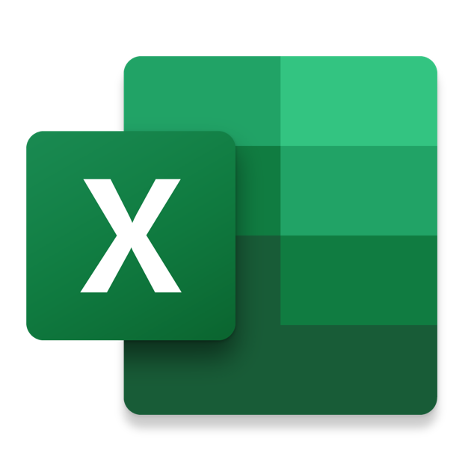


Supported data types
Relational DBMS
Structured Data
Schema-ed File
Excel
NoSQL DBMS
Semi-structured Data
JSON
XML
HTML
Semi-structured File
Word
PowerPoint
TEXT
Readable File
Binary file w/ metadata
TXT
JPG w/ EXIF
PNG w/ EXIF
Unstructured Data
01
101101101101
Binary file w/o metadata
WAV
Video w/o metadata
Binary data

Slide 10
Supported data types
 |  | DDL (Definition) | DML (Manipulation) | DQL (Query) | Data Ingestion
Structured Data | Relational DBMS | DBMS query | DBMS query | DBMS query | X
 | Schema-ed File | X | X | Schema query | Schema extraction
Semi-structured Data | NoSQL DBMS | X | DBMS query + Schema extraction | DBMS query | X
 | Semi-structured File | X | X | Schema query | Schema extraction
Unstructured Data | File w/ metadata | X | X | Metadata query | Metadata discovery
 | File w/o metadata | X | X | Tag Query | Manual tagging

Slide 11
Supported data types
SQL Query engine for heterogeneous
data sources (even NoSQL)
Search and Indexing engine
 |  | DDL (Definition) | DML (Manipulation) | DQL (Query) | Data Ingestion
Structured Data | Relational DBMS | Passthrough |  |  | X
 | Schema-ed File | X | X |  | Schema extraction
Semi-structured Data | NoSQL DBMS | X | Passthrough + Schema extraction |  | X
 | Semi-structured File | X | X |  | Schema extraction
Unstructured Data | File w/ metadata | X | X |  | Metadata discovery
 | File w/o metadata | X | X |  | Manual tagging

Slide 12

Data flow for DBMS data
1. Data Load
Passthrough the Insertion query
without modification
INSERT INTO fish (…)
INSERT
INTO fish
(…)
Oracle Database
Fish data
Fish data
SELECT * FROM
protein
WHERE …
Insert the fish data into Oracle Database
Protein data
2. Data Query
db.protein.find({…})
SELECT *
FROM protein
WHERE …
MariaDB
mongoDB
Protein data
Query to both
MariaDB and mongoDB
to retrieve Protein data
Conjugated Protein data

Slide 13
Data flow for file
1. Data Load & Index
Metadata Extractor
Store the file
into HDFS
Extract the
schema
HDFS
Medical data file
Insert the medical data SPSS file
(Structured Schema-ed file data)
Lookup the
SPSS file
01
011011011001
2. Data Search
ID schema ..
Medical data
TEXT
“ID”: {
“value”:
1001233
}
Query the data to retrieve the medical data of ID 1001233
Medical data of ID 1001233

Slide 14

Database Expansion Manager
Physically partitioning the data in RDBMS/NoSQL DBMS for distributing the data into multiple machines
To satisfy the Scale-out expansion capability for Data Lake
Use the Database Sharding feature in supported DBMS
  Shard: A horizontal partition of data in database
List of shard-able DBMS
Machine A
ID | Name | Protein
12 | 가다랑어 | 25.9
14 | 가래상어 | 22.2
15 | 갈치 | 18.5
17 | 감성돔 | 18.8
ID | Name | Protein
12 | 가다랑어 | 25.9
14 | 가래상어 | 22.2
15 | 갈치 | 18.5
17 | 감성돔 | 18.8
18 | 갑오징어 | 15.1
20 | 갈가자미 | 18.3
Machine B
ID | Name | Protein
18 | 갑오징어 | 15.1
20 | 갈가자미 | 18.3
Original Data
Data Shards

Slide 15
Supported data source
질병관리본부 국민건강영양조사
National individual medical survey data
Format: SPSS statistics file data
식품안전나라 식품영양성분DB
Nutrition Component Database
Format: MS Excel file data
SNS data (Facebook, Twitter and Instagram)
Private RS - based on each user’s own SNS history (social login required)
Private RS (Recommendation System) - based on each user’s own medical survey
Food knowledge base for general purpose
Format: JSON/HTML streaming (or file) data
Common RS - track the seafood name’s frequency and expect the popularity
For seafood recommendation system

Slide 16
Conclusion
In this research, we proposed an architecture design of Data Lake which support all the Relational DBMS data, NoSQL DBMS data and file data. Comparing with other related works, our proposed architecture have a strong point in supporting the scale-out expansion for both Relational DBMS and NoSQL DBMS using their Sharding feature. This makes the Data Lake to have a capability to be fully-distributed.
For integration the Relation DBMS with the NoSQL DBMS, and for JOIN operation of them, we used Apache Drill. For indexing the metadata and searching the specific data in file which stored in HDFS, we used a Lucene-based search engine Elasticsearch.
Our proposed Data Lake architecture is for Seafood recommendation system with supported data sources, and it can be used for any general purposes.

Slide 17
References
(Miloslavskaya, 2016) Natalia Miloslavskaya, and Alexander Tolstoy. 2016. “Big Data, Fast Data and Data Lake Concepts.” Procedia Computer Science 88: 300–305.
(Hai, 2016) Rihan Hai, Sandra Geisler, and Christoph Quix. 2016. “Constance: An Intelligent Data Lake System.” In Proceedings of the 2016 International Conference on Management of Data, 2097–2100.
(Beheshti, 2017) Amin Beheshti, Boualem Benatallah, Reza Nouri, Van Munin Chhieng, HuangTao Xiong, and Xu Zhao. 2017. “CoreDB: A Data Lake Service.” In Proceedings of the 2017 ACM on Conference on Information and Knowledge Management, 2451–54.
(Farid, 2016) Mina Farid, Alexandra Roatis, Ihab F. Ilyas, Hella-Franziska Hoffmann, and Xu Chu. 2016. “CLAMS: Bringing Quality to Data Lakes.” In Proceedings of the 2016 International Conference on Management of Data, 2089–92.

Slide 18
Thank you
감사합니다
Jongmin Kim
jmkim@pukyong.ac.kr
!

